Slide 1

Introduction to Assistive Technology and Universal Design Heather B. Smith, MS, OTR/L, ATP, CBIS, CSRS

Slide 2

Assistive Technology Professional, Certified Brain Injury Specialist, Certified Stroke Rehabilitation Specialist
Occupational Therapist with 20 years of experience
Currently works at Carolinas Rehabilitation Main in Charlotte on the Brain Injury team and Assistive Technology Clinical Specialist
Introduction
Notes:
Before we dive into the main topic, I want to introduce myself—and this is where technology already starts to play a role. The headshot you're looking at wasn’t taken in a studio or by a photographer—it was created by artificial intelligence. It’s a small but meaningful example of how assistive technologies can support creativity, accessibility, and self-presentation. For someone who might not have easy access to professional photography, tools like these are incredibly empowering. And that's exactly what today’s talk is about: technology that assists, enhances, and includes all people. Its not perfect, I have brown eyes in the picture and green eyes in real life but I was able to take 6 selfies on my cellphone during lunch and an hour later I had 30 "headshots" to chose from.
I'm an Occupational Therapist with 20 years of experience, and I currently work at Carolinas Rehabilitation Main in Charlotte as part of the Brain Injury team. I'm also a Certified Assistive Technology Professional, a Certified Brain Injury Specialist, and a Certified Stroke Rehabilitation Specialist.
While being at this conference, I have been reflecting on how I got here. My oldest brother, Brent, had brain cancer when he was 4 which left him with significant cognitive difficulties. I remember from a young age being the person that connected to him. I was lucky enough to be that person until he passed in 2004. Now, I'm a secondary caregiver to my mother who is battling Alzheimers. So, this isn't just my occupation, its my life.
My work focuses on helping people regain independence after life-changing events like strokes or traumatic brain injuries. Over the years, I’ve seen how the right technology—when it’s accessible and thoughtfully applied—can truly change lives. That’s why I’m passionate about sharing tools and devices that are not only effective but also available to the public. Today, I’ll be showing you real-world examples of assistive technologies that empower people to live more independently, more confidently, and more fully.

Slide 3
Objectives
Identify
Identify assistive technology and universal design needs
Describe
Describe the potential applications of assistive technology in home and community settings.
Review
Review the benefits of assistive technology in enhancing independence in daily life.
Identify
What you can do to make a difference it peoples ability to reach their goals and be independent!
Notes:
In today’s presentation, we’re going to start by identifying assistive technology that’s readily available in the community—things you can find online, in stores, or through local programs. Then, we’ll look at how this technology can be used in real-life home and community settings to support daily tasks, communication, mobility, and safety. We’ll also review the key benefits of assistive technology, especially how it can enhance independence and improve overall quality of life. And finally, we’ll talk about different ways to access these tools—whether through commercial vendors, support programs, or professional services—so you know where to go when you or someone you’re working with needs support.

Slide 4

What is Assistive Technology?
An intervention to improve a persons' performance, enable participation or maintain meaningful engagements
Can be as simple as Velcro fasteners to complex computer software
Bridges the gap between what the person wants and needs to do and what they are capable of
Technology may be limited by the user's ability to implement it
AJOT, November/December 2016, Vol. 70, Assistive Technology and Occupational Performance
Notes:
So let’s start with a foundational question: what is assistive technology or AT?
At its core, assistive technology is an intervention. It’s not just about gadgets or devices—it’s about improving a person’s performance, enabling their participation, or helping them maintain the things that give their life meaning.
And it spans a wide range. It could be something as simple as a Velcro fastener that allows someone to dress independently, or something as advanced as a speech-generating device or custom software that enables someone to work, communicate, or learn. Also, assistive technology becomes built in to our daily livings. Think about curb cutouts and Automatic door opens- originally for wc users but now widely used by all people such as parents with strollers, kids on bikes. Also , I remember my guidance counselor in elementary school had a limb loss. She spoke about when she had her first baby she wasn't able to pin the cloth diaper with her prosthetic and would tape the sides. Fastforward, diapers now come with taped closures (she always joked she should have patented it and would have been rich now).
What’s powerful about assistive technology is that it bridges the gap—it connects what someone wants or needs to do with what they’re currently able to do. It’s a bridge between aspiration and action.
But it’s also important to remember that the technology is only as effective as the person’s ability to use it. If a tool is too complex, too expensive, or poorly matched to the user’s needs, it doesn’t serve its purpose. So successful assistive tech is as much about the human as it is about the hardware.

Slide 5
Why is it important?
Increases Independence
Improves functional outcomes
Increases safety; both in the community and at home
Notes:
One of the most powerful things about assistive technology is its ability to support real-life goals—things that matter deeply to the people using it.
First and foremost, AT promotes independence. Whether it’s a mobility aid, a communication device, or a simple kitchen tool, the right technology can reduce reliance on caregivers and empower people to manage daily tasks on their own terms.
It also improves functional outcomes. That might mean better performance in school or work, smoother participation in daily routines, or more successful social engagement. The tech doesn’t do the task for the person—it helps them do it themselves, more effectively.
And let’s not forget about safety, both at home and in the community. From fall detection devices to medication reminders to adaptive driving aids, AT helps prevent accidents and enables people to navigate their environments with more confidence.
Ultimately, assistive technology isn’t about replacing human support—it’s about enhancing capability, building confidence, and increasing quality of life

Slide 6
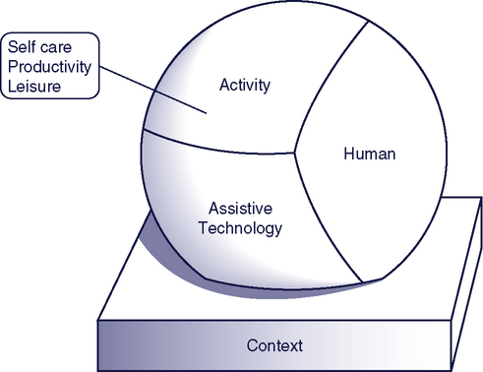
Human Activity Assistive Technology Model
HAAT model- Humans are completing and activity, in a context with assistive technology.
This is where utilizing a professional may be helpful in linking technology with a person and educating on its use/applications
Cook et al.
Notes:
To better understand how we can make the most of commercially available technology, it helps to use a framework like the HAAT model—the Human Activity Assistive Technology model.
This model reminds us that assistive technology doesn’t exist in isolation. It's part of a bigger picture, where a human is trying to complete an activity, within a specific context, using a piece of technology.
With commercially available tools—like smart speakers, tablets, or wearable devices—it becomes especially important to consider all the elements of the HAAT model.
For example, the same device might work great for one person at home, but not be practical for someone else in a busy work environment. The user’s abilities, the task they’re trying to do, and the setting all affect whether the technology is actually helpful.
This is where involving a professional—like an occupational therapist, assistive tech specialist, or rehab engineer—can make a big difference. They can help assess the fit between the person and the tool, make necessary adaptations, and provide training or support so that the technology is actually used effectively.

Slide 7

HAAT Model In Action
Does my father's iPhone, being used alone, at his home serve the purpose he needs? (or I need)
Notes:
So let’s start with a foundational question: what is assistive technology or AT?
At its core, assistive technology is an intervention. It’s not just about gadgets or devices—it’s about improving a person’s performance, enabling their participation, or helping them maintain the things that give their life meaning.
And it spans a wide range. It could be something as simple as a Velcro fastener that allows someone to dress independently, or something as advanced as a speech-generating device or custom software that enables someone to work, communicate, or learn. Also, assistive technology becomes built in to our daily livings. Think about curb cutouts and Automatic door opens- originally for wc users but now widely used by all people such as parents with strollers, kids on bikes. Also , I remember my guidance counselor in elementary school had a limb loss. She spoke about when she had her first baby she wasn't able to pin the cloth diaper with her prosthetic and would tape the sides. Fastforward, diapers now come with taped closures (she always joked she should have patented it and would have been rich now).
What’s powerful about assistive technology is that it bridges the gap—it connects what someone wants or needs to do with what they’re currently able to do. It’s a bridge between aspiration and action.
But it’s also important to remember that the technology is only as effective as the person’s ability to use it. If a tool is too complex, too expensive, or poorly matched to the user’s needs, it doesn’t serve its purpose. So successful assistive tech is as much about the human as it is about the hardware.

Slide 8
Assistive Technology for
Everyday Use
Dressing
Smart Medication
Smart Assistants
Smart Plugs
Smart Lights
Smart Kitchen Appliances
Door Openers
Smart Thermostats
Smart Window Shades
Adaptive Gaming
Apple Devices
And many more!
Notes:
This slide gives you a sense of just how wide the world of assistive and smart technology has become—especially when we tap into commercially available tools.
Starting with dressing, we will be going through various examples of adaptive dressing that allow for seamless dressing. More and more popular brands are beginning to make clothing with access in mind.
Smart medication systems offer reminders, alerts, and caregiver syncing—helping to manage complex regimens and promote safety.
Smart assistants like Alexa or Google Home are incredibly versatile—they can control other devices, answer questions, set routines, and even help individuals with cognitive support needs.
Smart plugs and smart lights increase both accessibility and safety, especially for individuals with limited mobility or vision challenges.
In the kitchen, smart appliances can simplify tasks, improve safety, and even walk someone through a recipe step-by-step.
We also see devices like automatic door openers, smart thermostats, and motorized window shades—all of which can be controlled by voice or app to reduce physical strain and improve access to the environment.
Beyond daily living tasks, we’re seeing an expansion into adaptive gaming—which is huge for both recreation and inclusion—and platforms like Apple are increasingly integrating accessibility features right into their devices.
And of course—this is just the start. There are so many more tools out there. The key is not just knowing what exists, but finding the right fit for the person, the activity, and the context—just like we talked about with the HAAT model.

Slide 9
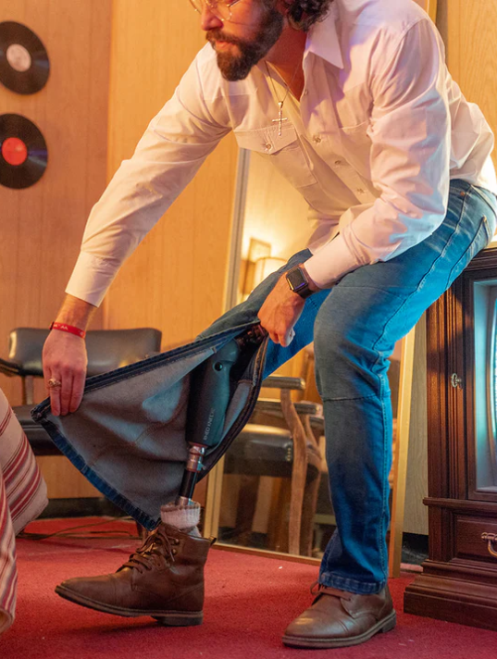

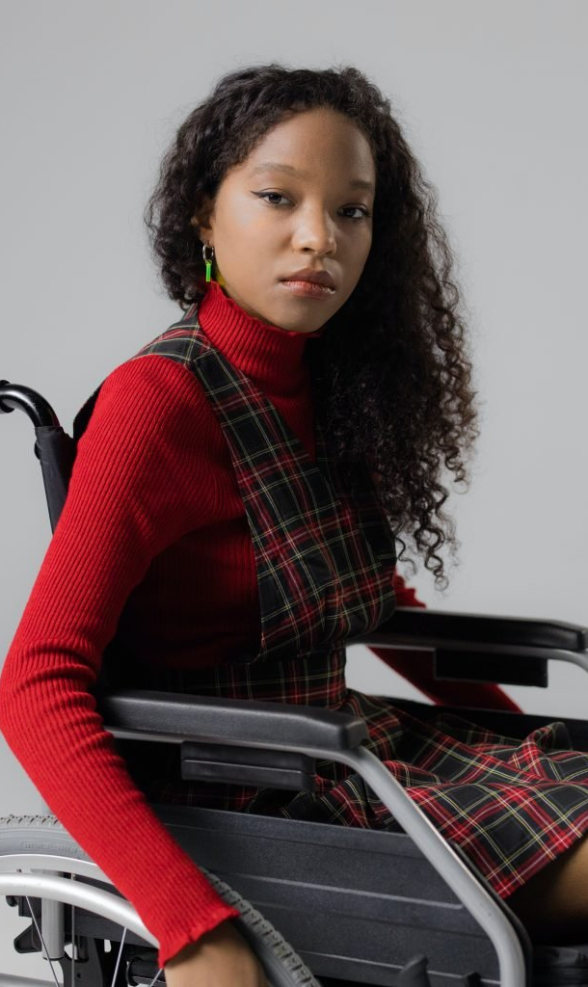
Dressing
Notes:
adaptive dressing.
Several well-known clothing brands now offer specialized adaptive clothing designed specifically for individuals with physical disabilities or challenges.
These clothing lines focus on ease of use, making it simpler to put on or take off clothes. For example, many pieces feature magnetic closures, Velcro, or side openings—all designed to minimize fine motor challenges and improve independence when dressing.
Elastic waistbands are another common feature, replacing zippers or buttons, and making it easier to manage without requiring dexterity.
These innovations not only promote independence, but also offer comfort and style, so people don’t have to compromise on fashion while addressing functional needs.
And it’s not just about accessibility—it’s about empowerment. Being able to dress independently can boost self-esteem and make a huge difference in a person’s daily life.
Several popular clothing brands offer adaptive dressing options,: Velcro and magnetic closures, side openings, tailoring for wheelchair users and many more

Slide 10
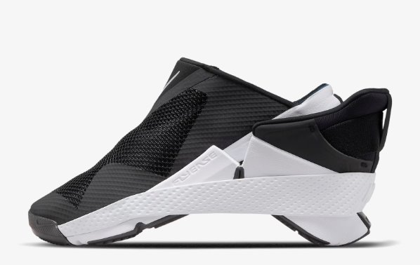
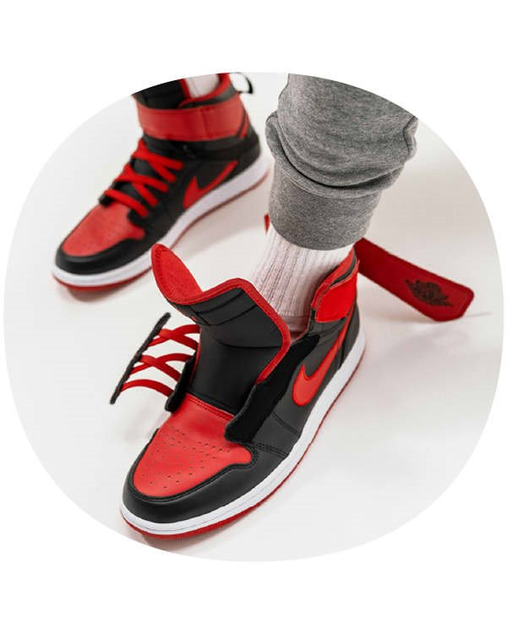
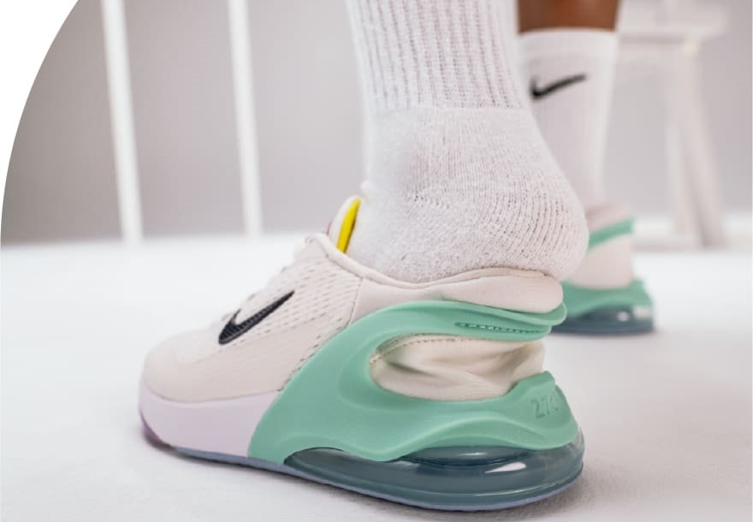
Nike
Nike has a line of adaptive shoes.
These include Air Jordans
Men's, women's and children
Athletic shoes including cleats
Notes:
Nike is another major brand stepping into the world of adaptive footwear—and doing it in a way that blends performance, accessibility, and style.
Nike’s adaptive shoe line includes popular models like Air Jordans, and it’s available across men’s, women’s, and kids’ sizes. What’s even more exciting is that they’ve extended adaptive design into athletic footwear, including cleats—giving people of all abilities the tools to participate in sports.
One of the standout designs is the Nike Go FlyEase, which uses a unique bi-stable hinge and tensioner system that allows users to step in and out of the shoe completely hands-free. This model retails around $120–$150, making it competitively priced alongside their regular performance shoes.
Then you have adaptive Air Jordans—these start at about $125 and go up, depending on the model, offering classic style in a more accessible form.
Nike also includes adaptive cleats and training shoes in its FlyEase line, catering to athletes who want to stay in the game without needing help getting ready.
What’s important here is that Nike is showing that inclusion can be mainstream. These are shoes you can find at any major retailer or online—no need for a specialty medical catalog. That’s independence in action. People can choose what they like, what fits their lifestyle—and they can put their shoes on by themselves, every time.

Slide 11
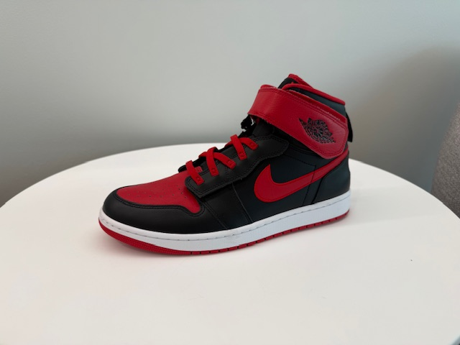
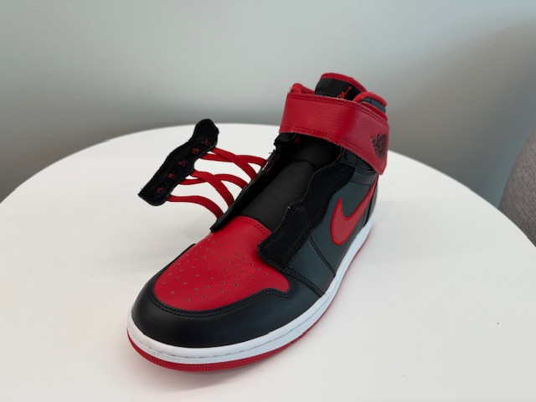
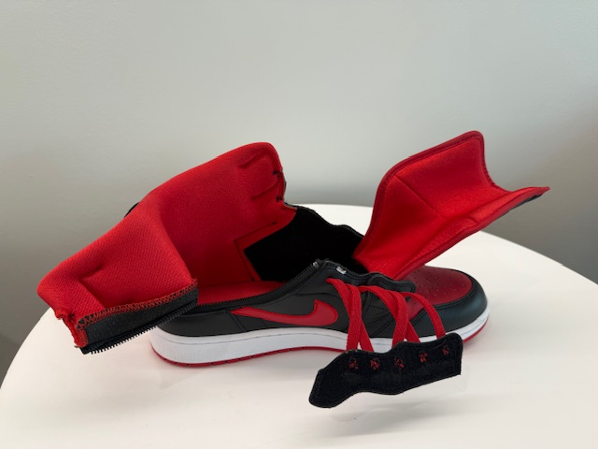
Easy On Jordans
Notes:
This is my patient with quad limb loss. He is a huge sneaker head and these are a pair of his Jordans! The ease to put them on his prosthetic is a huge time saver.

Slide 12
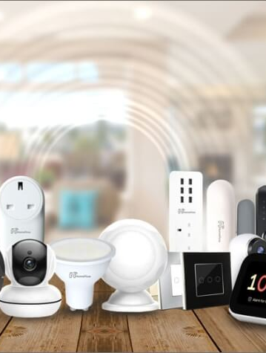
Smart Home
Smart home appliances are designed to make everyday tasks more convenient and efficient by using automation, remote control, and intelligent technology.
Notes:
Let’s shift our focus to smart home technology—a growing area of assistive tech that’s making it easier than ever to live independently at home.
Smart home appliances are designed to make everyday tasks more convenient, efficient, and safer. They use a combination of automation, remote control, and intelligent technology to help with things like turning on lights, adjusting the thermostat, or even checking who’s at the door—often with just a voice command or a tap on a phone.
For individuals with mobility challenges, memory impairments, or sensory limitations, these tools can remove daily barriers and promote autonomy.
Whether it’s a smart speaker that can turn off appliances, a robot vacuum that cleans floors without bending or lifting, or a video doorbell that provides security and visibility—these devices help people remain in their homes longer and with more confidence.
And the best part? These technologies are commercially available, affordable, and easy to install, with options for renters and homeowners alike.
As we go through some examples, think about how just a few of these changes can empower someone to live more independently and safely in their own space.

Slide 13

Examples of Alexa

Slide 14
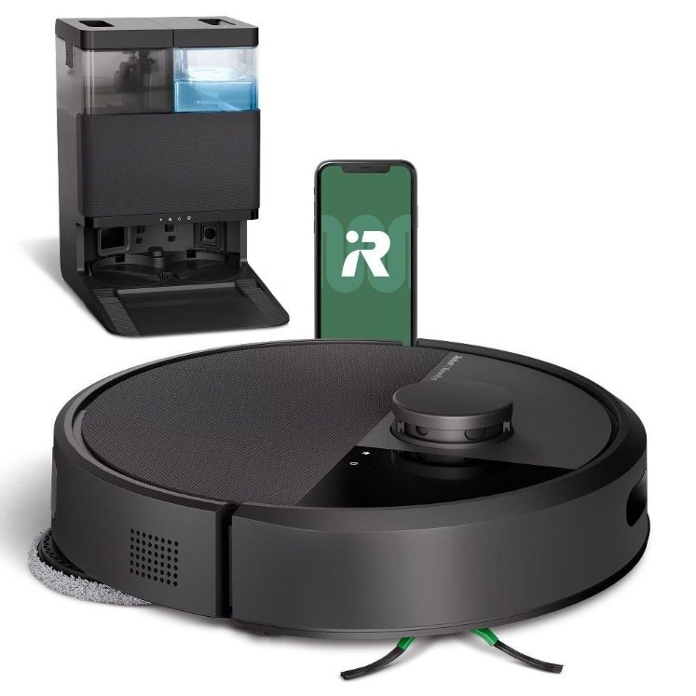
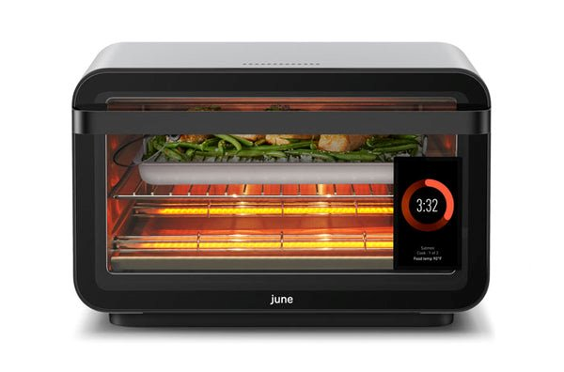
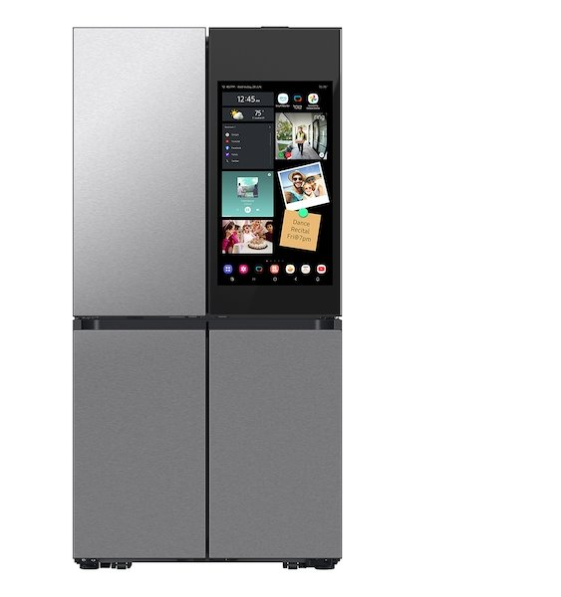
Smart Kitchen Appliances
Samsung Family Hub Refrigerator​
Roomba Vacuum/Mop​
June Oven
Notes:
Smart kitchen appliances are revolutionizing how we manage our homes, offering automation and intelligent features that enhance convenience and promote independence.
June Oven: This countertop smart oven utilizes built-in cameras and sensors to recognize food, recommend optimal cooking settings, and send alerts when your meal is ready. It's priced at approximately $599 for the standard model, with premium packages available at higher price points.
Samsung Family Hub Refrigerator: A high-tech refrigerator featuring a touchscreen interface, internal cameras, and smart home integration. It assists with grocery management, meal planning, and even entertainment. Prices range from $2,799 to $3,869, depending on the model and features.
Roomba Robot Vacuum and Mop: These robotic cleaners automate floor maintenance, with models offering vacuuming, mopping, and self-emptying capabilities. Prices vary:
Roomba Combo i5: Currently discounted to $199.99 from $349.99.
Roomba Combo j5: Available for $249.99, down from $529.99.
Roomba Combo j7+: Priced at $599.99, reduced from $999.99.
These appliances not only simplify daily tasks but also empower individuals to maintain their homes with greater autonomy and ease."

Slide 15
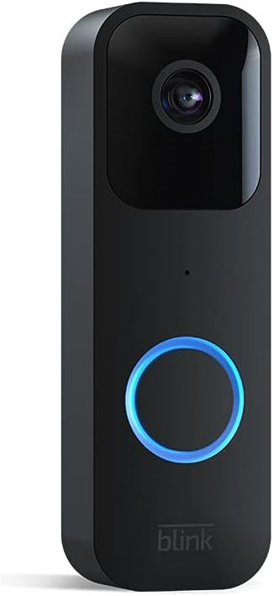
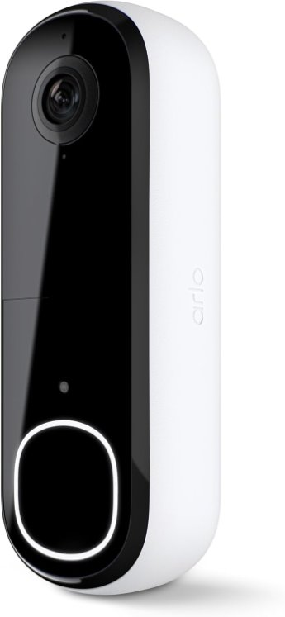
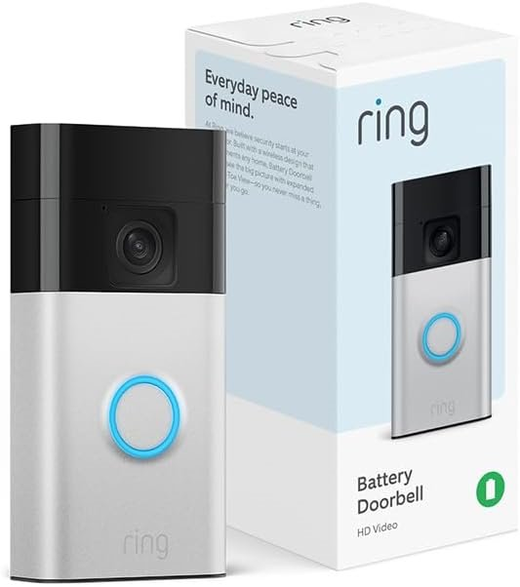
Smart Doorbells
Blink Doorbell
Arlo Doorbell
Ring Doorbell
Notes:
Smart doorbells like Ring, Blink, and Arlo are great examples of commercially available assistive technology that promote independence—especially for individuals with mobility challenges, cognitive differences, or hearing impairments.
These devices offer features like live video, two-way audio, motion detection, and smartphone alerts, enabling users to see who’s at the door without needing to physically get up or even be home.
Ring: Starts around $100, with subscription plans from $3.99/month for video recording.
Blink Video Doorbell: More affordable, starting at about $60, also with optional cloud storage.
Arlo Essential Video Doorbell: Around $130, offering high-definition video and smart alerts.
By integrating these into daily life, individuals gain more control over their environment, reduce reliance on caregivers, and increase personal safety—all of which contribute to greater independence.

Slide 16
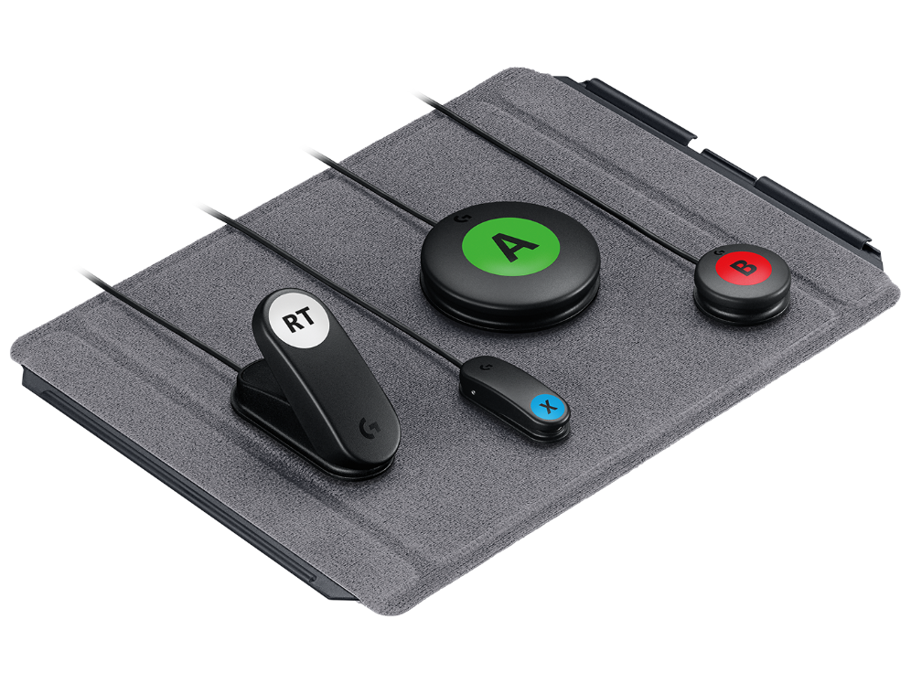
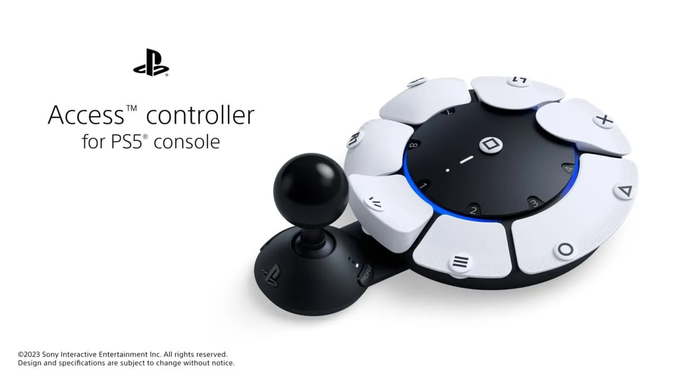
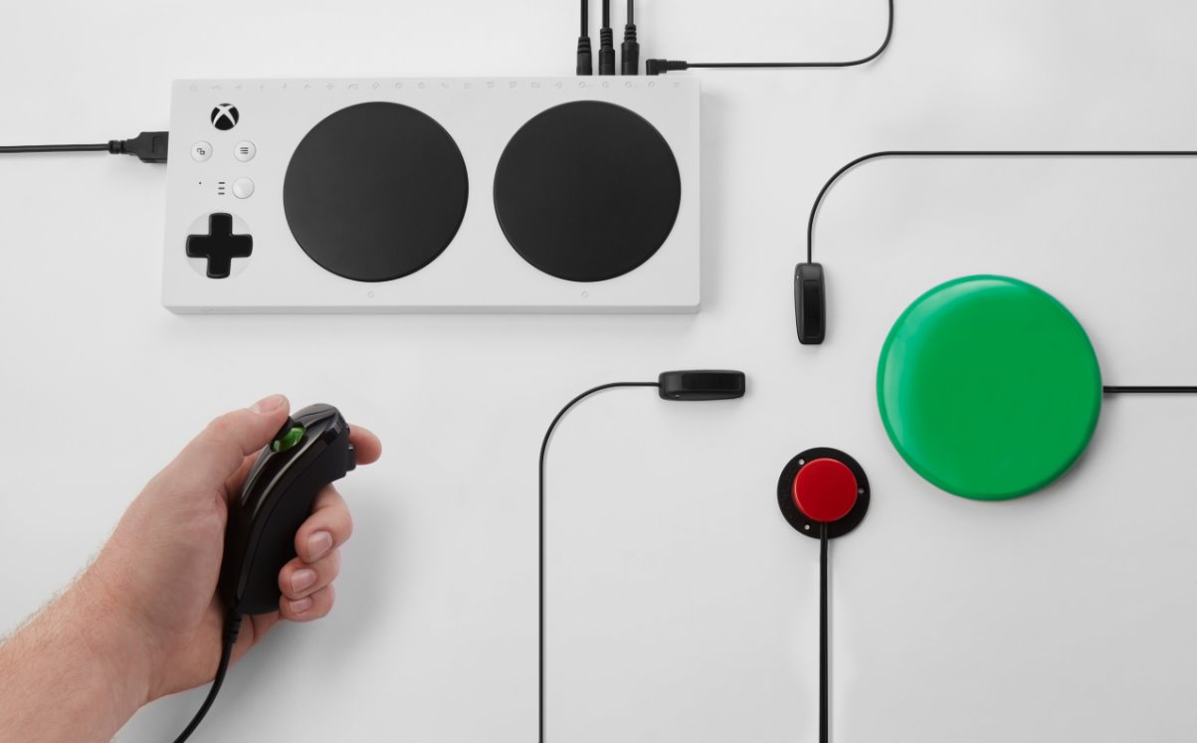
Adaptive Gaming
Makes video games more accessible and enjoyable for a broader range of players, especially those with disabilities. The idea is to adapt or modify gaming experiences to meet the diverse needs of players, enabling them to engage with games in ways that are comfortable and fair.
PS5- Access Controller
Logitech Adaptive ​Gaming Kit
XBOX Adaptive Controller​
Notes:
Adaptive gaming technology makes video games more accessible and enjoyable for a broader range of players, especially those with disabilities. By adapting traditional gaming setups to accommodate different physical and cognitive needs, these tools empower users to engage with games in ways that are comfortable, fair, and fully personalized. From remappable buttons to customizable switches, adaptive gaming fosters greater inclusion and independence in recreational play.
Notable commercial options include the PS5 Access Controller, Xbox Adaptive Controller, and the Logitech Adaptive Gaming Kit. The PS5 Access Controller (approx. $90 USD) features a flexible design with swappable stick caps and customizable input profiles. The Xbox Adaptive Controller (around $100 USD) acts as a central hub for external devices like switches, buttons, and joysticks, offering maximum configurability. Complementing it is the Logitech Adaptive Gaming Kit (approx. $100 USD), which includes a set of high-quality, durable switches, buttons, and gamepad-style inputs that connect directly to the Xbox Adaptive Controller, giving players even more control options.
Together, these tools are breaking barriers in gaming—ensuring that fun, competition, and creativity are truly for everyone.

Slide 17
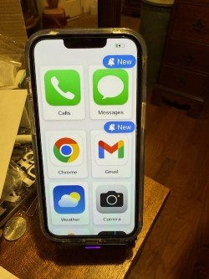
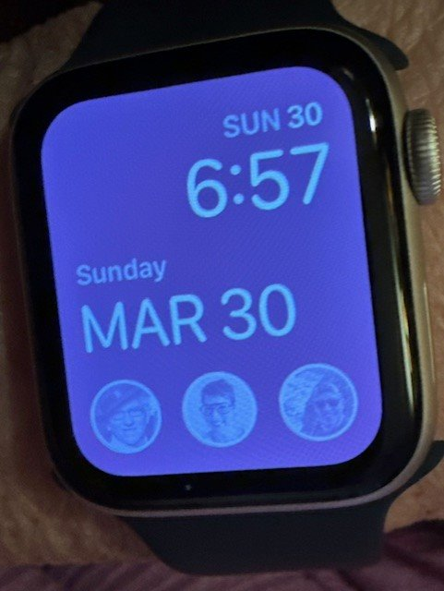
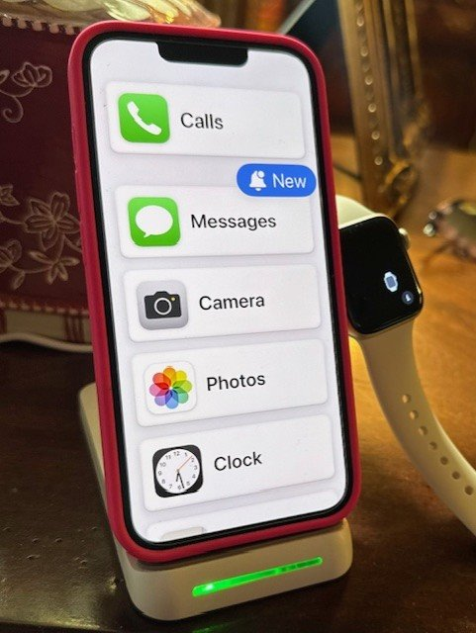
Apple
Apple has long been a leader in providing assistive technology to make its devices accessible to a wide range of users, including those with disabilities. The company has integrated numerous features into its devices—iPhones, iPads, Macs, and more—that help users with visual, hearing, motor, and cognitive impairments.
Notes:
I could seriously do a whole presentation on Apple! I'll hit a few key points here.
Apple has long been a leader in assistive technology, designing its devices with accessibility at the core—not as an afterthought. Across iPhones, iPads, Macs, Apple Watches, and more, the company integrates powerful tools that support users with visual, hearing, motor, and cognitive impairments. These features are built into the operating system and require no additional downloads, making accessibility seamless and inclusive right out of the box.
For users with visual impairments, Apple offers VoiceOver, a gesture-based screen reader, as well as Magnifier, Display & Text Size adjustments, and Braille display support. For individuals who are deaf or hard of hearing, there are Live Captions, Sound Recognition, Mono Audio, and Made for iPhone hearing aid integration. Those with motor limitations can benefit from Switch Control, AssistiveTouch for easier gestures, and Voice Control, which allows full device navigation using only speech. Apple also provides tools like Guided Access and Background Sounds to support cognitive accessibility, helping users stay focused and manage sensory input. The newest models of iPhones also offer eye gaze technology.
The picture in the middle is an example of an apple watch. The Apple Watch is equipped with several safety features that provide peace of mind, particularly in emergency situations. One of the key features is Fall Detection, which automatically detects a hard fall and can notify emergency services if the wearer is unresponsive. The Emergency SOS function allows users to quickly alert emergency contacts and local authorities by pressing and holding the side button. If the wearer is unable to speak, the watch will send an automatic message with location information. In addition, Emergency Contacts are easily accessible, and users can quickly make phone calls through the watch by pressing and holding the side button to trigger the SOS feature or through the Phone app. With Cellular models, the Apple Watch can make calls even if the user’s iPhone isn’t nearby, providing an added layer of independence for users who may be at risk. These features, along with real-time location tracking and integration with other safety apps, ensure that users stay connected and secure, no matter the situation. In this example, this is my mothers watch where she is easily able to see my picture as well as my father and brother to quickly make calls from her watch.
The pictures on the right are examples of adding Assistive Access to an iphone. Assistive Access is a powerful feature introduced by Apple to simplify the iPhone interface for users with cognitive disabilities. Designed with input from disability communities, Assistive Access offers a streamlined experience by reducing complexity, decluttering the screen, and focusing on essential functions like calls, messages, photos, music, and camera. It replaces the traditional iOS home screen with large buttons, high-contrast visuals, and easy-to-read text, making navigation more intuitive and less overwhelming. Caregivers or users can customize which apps are visible, how they appear (grid or list view), and limit access to settings for a more focused, supportive experience. Assistive Access empowers individuals with cognitive challenges to use iPhones more independently and confidently—enhancing communication, connection, and autonomy.
What sets Apple apart is its commitment to universal design—creating technology that’s intuitive, empowering, and inclusive for everyone, without needing specialized hardware or expensive add-ons.

Slide 18
Apple
Apple has long been a leader in providing assistive technology to make its devices accessible to a wide range of users, including those with disabilities. The company has integrated numerous features into its devices—iPhones, iPads, Macs, and more—that help users with visual, hearing, motor, and cognitive impairments.
Notes:
I could seriously do a whole presentation on Apple! I'll hit a few key points here.
Apple has long been a leader in assistive technology, designing its devices with accessibility at the core—not as an afterthought. Across iPhones, iPads, Macs, Apple Watches, and more, the company integrates powerful tools that support users with visual, hearing, motor, and cognitive impairments. These features are built into the operating system and require no additional downloads, making accessibility seamless and inclusive right out of the box.
For users with visual impairments, Apple offers VoiceOver, a gesture-based screen reader, as well as Magnifier, Display & Text Size adjustments, and Braille display support. For individuals who are deaf or hard of hearing, there are Live Captions, Sound Recognition, Mono Audio, and Made for iPhone hearing aid integration. Those with motor limitations can benefit from Switch Control, AssistiveTouch for easier gestures, and Voice Control, which allows full device navigation using only speech. Apple also provides tools like Guided Access and Background Sounds to support cognitive accessibility, helping users stay focused and manage sensory input. The newest models of iPhones also offer eye gaze technology.
The picture in the middle is an example of an apple watch. The Apple Watch is equipped with several safety features that provide peace of mind, particularly in emergency situations. One of the key features is Fall Detection, which automatically detects a hard fall and can notify emergency services if the wearer is unresponsive. The Emergency SOS function allows users to quickly alert emergency contacts and local authorities by pressing and holding the side button. If the wearer is unable to speak, the watch will send an automatic message with location information. In addition, Emergency Contacts are easily accessible, and users can quickly make phone calls through the watch by pressing and holding the side button to trigger the SOS feature or through the Phone app. With Cellular models, the Apple Watch can make calls even if the user’s iPhone isn’t nearby, providing an added layer of independence for users who may be at risk. These features, along with real-time location tracking and integration with other safety apps, ensure that users stay connected and secure, no matter the situation. In this example, this is my mothers watch where she is easily able to see my picture as well as my father and brother to quickly make calls from her watch.
The pictures on the right are examples of adding Assistive Access to an iphone. Assistive Access is a powerful feature introduced by Apple to simplify the iPhone interface for users with cognitive disabilities. Designed with input from disability communities, Assistive Access offers a streamlined experience by reducing complexity, decluttering the screen, and focusing on essential functions like calls, messages, photos, music, and camera. It replaces the traditional iOS home screen with large buttons, high-contrast visuals, and easy-to-read text, making navigation more intuitive and less overwhelming. Caregivers or users can customize which apps are visible, how they appear (grid or list view), and limit access to settings for a more focused, supportive experience. Assistive Access empowers individuals with cognitive challenges to use iPhones more independently and confidently—enhancing communication, connection, and autonomy.
What sets Apple apart is its commitment to universal design—creating technology that’s intuitive, empowering, and inclusive for everyone, without needing specialized hardware or expensive add-ons.

Slide 19
Websites of Items
CLOTHING​
Tommy HIlfiger Adaptive- https://usa.tommy.com/en/tommy-adaptive​
Magna-Ready- https://magnaready.com/​
Khols Adaptive line- https://www.kohls.com/feature/adaptive-clothing-guide.jsp?icid=sl-nav-adptve-clothing-total-productguide​
SHOES​
Zappo Adaptive- https://www.zappos.com/c/adaptive​
Nike- https://www.nike.com/w/mens-easy-on-off-shoes​
​
SMART HOME​
Assistance/speakers​
Amazon Alexa- https://www.amazon.com/alexa​
Google Nest Hub- https://store.google.com/us/product/nest_hub_2nd_gen?hl=en-US​
Apple HomePod- https://www.apple.com/homepod/​
Plugs​
TP-Link https://www.tp-link.com/us/home-networking/smart-plug/​
Amazon Smart Plug- https://www.amazon.com/Amazon-smart-plug-works-with-Alexa​
​

Slide 20
Websites of Items
SMART HOME​
Appliances​
Samsung Family Hub Refrigerator- https://www.samsung.com/us/explore/family-hub-refrigerator/overview/​
June Oven- https://juneoven.com/pages/smart-oven​
Roomba Vacuums/Mops- https://www.irobot.com/​
Door Openers​
Open Sesame- https://www.opensesamedoor.com/​
​
Doorbell​
Blink- https://www.amazon.com/Blink-Video-Doorbell/​
Arlo- https://www.arlo.com/​
Ring- https://ring.com/​
Thermostats​
Nest- Log into the Nest app​
Ecobee- https://www.ecobee.com/​
Amazon Smart Thermostat- https://www.amazon.com/Amazon-Smart-Thermostat/dp/B08J4C8871

Slide 21
Websites of Items
SMART HOME
Shades
Lutron- Custom Smart Blinds and Shades | Serena Shades by Lutron
Ikea Fyrtur Smart Blinds- Motorized Blinds - Automatic Smart Electric Blinds - IKEA
Gaming
Playstation 5- Access Controller- Access controller | A customizable, adaptive controller kit for PS5 | PlayStation (US)
X-Box Adaptive Controller- https://www.xbox.com/en-US/accessories/controllers/xbox-adaptive-controller
LogiTech Adaptive Gaming Kit- https://www.logitechg.com/en-us/products/gamepads/adaptive-gaming-kit-accessories.943-000318.html
Medicines
MedMinder Smart Pill Dispenser- MedMinder Personalized At-Home Pharmacy
Pill Drill- Home
Amazon PIll Pack- https://pharmacy.amazon.com/pillpack
Apple
Apple Accessibility- Accessibility - Apple

Slide 22
References
AJOT, November/December 2016, Vol. 70, Assistive Technology and Occupational Performance​
American Journal of Occupational Therapy- Assistive Technology and Occupational Performance. ​
Cook, A. M., Polgar, J. M., & Encarnação, P. (2020). Assistive technologies: Principles & practice. St. Louis, MO: Elsevier.​
Kruse, David, et al. "Assistive Technology's Potential to Improve Employment of People with Disabilities." Journal of Occupational Rehabilitation, vol. 34, no. 2, 2024, pp. 299-315. doi:10.1007/s10926-023-10164-w.​
​

Slide 23
Thank you!
Questions?
What do you wish existed?
Now, can you make it????
Heather B. Smith, MS, OTR/L, ATP, CBIS, CSRS
heather.smith1@atriumhealth.org

